Slide 1
B25 FIT LEVEL 01 PROJECT
Faculty of Information Technology | University of Moratuwa
LiDAR
3D
LiDAR-Based 3D Scanner
PRECISION • AUTOMATED • CLOUD ENABLED
IT25001 | A.B.C. Fernando | BSc (Hons) IT IT25002 | D.E.F. Perera | BSc (Hons) IT IT25003 | G.H.I. Silva | BSc (Hons) IT IT25004 | J.K.L. Rajapaksa | BSc (Hons) IT IT25005 | M.N.O. Wickramasinghe | BSc (Hons) IT
Supervisor: Dr. [Supervisor Name] — Department of Information Technology
2025 / 2026 Academic Year | ⚑ Replace placeholder names, index numbers & supervisor name with actual details

Slide 2
01 — INTRODUCTION
2 / 12
What is 3D Scanning?
⚙
Technology
3D scanning is the process of capturing the shape of physical objects and converting them into precise digital 3D models.
LiDAR (Light Detection And Ranging) is one of the most powerful technologies for 3D scanning, using laser pulses to measure distances with millimetre-level precision.
This project builds a bench-top LiDAR scanner using a rotating turntable and a 360° spinning LiDAR sensor, controlled by an ESP32 microcontroller, capable of generating point clouds and 3D mesh models uploaded to the cloud.
360° Time-of-Flight LiDAR + motorised turntable + cloud pipeline
🎯
Application Area
Heritage preservation, reverse engineering, AR/VR content creation, education
👥
Team
5-member multidisciplinary capstone team covering HW, SW, ME, Data & UX

Slide 3
02 — AIM & OBJECTIVES
3 / 12
🎯 AIM
To design and build a precision LiDAR-based 3D scanner that automatically captures dense point clouds of medium-sized objects, generates 3D mesh models, and uploads results to cloud storage — completed within a 12-month capstone project by a 5-member team.
01
Sub-cm Accuracy
02
Automated Rotation
03
Real-time Data Capture
Achieve ≤2 mm accuracy on reconstructed 3D shapes using LiDAR ToF measurement.
Implement stepper motor control for 360° automated turntable rotation with 0.09° resolution.
Stream and buffer LiDAR point cloud data synchronised with turntable angle in real time.
04
3D Mesh Generation
05
Cloud Upload
06
Web Dashboard
Process raw point clouds through filtering, registration, and Poisson surface reconstruction.
Transmit compressed 3D files (PLY/OBJ/STL) to AWS S3 or Firebase via Wi-Fi over HTTPS.
Provide a React-based web interface to view, download, and share generated 3D models.

Slide 4
03 — PROBLEM & PROPOSED SOLUTION
4 / 12
⚠ PROBLEMS IDENTIFIED
✔ PROPOSED SOLUTION
High Cost
Low-Cost LiDAR Scanner
Commercial 3D scanners (e.g. Artec, FARO) cost $10,000–$100,000+, limiting access for education and small teams.
Use YDLIDAR X4 (~LKR 30,000) on a custom turntable — total BOM under LKR 75,000.
Manual Processes
Fully Automated Operation
Manual photogrammetry and structured-light scanning require extensive setup time and expertise.
ESP32-controlled stepper motor automates full 360° scan cycle with one button press.
No Cloud Pipeline
Integrated Cloud Pipeline
Most affordable DIY scanners lack automated cloud upload or remote access capabilities.
Wi-Fi upload to AWS S3/Firebase with Flask API backend and 3D web viewer.
Limited Portability
Open-source & Modular
Existing academic projects are not modular or reproducible for capstone teams with limited budgets.
PCL + Open3D processing pipeline. Modular hardware allows easy upgrade or repair.

Slide 5
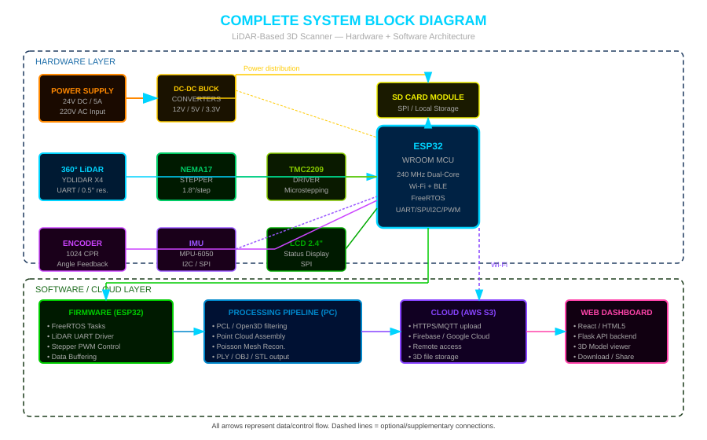
04 — IMPLEMENTATION | System Block Diagram
5 / 12

Slide 6
04 — IMPLEMENTATION | Data Flow & Workflow
6 / 12
1
2
3
4
5
6
7
PLACE
OBJECT
START
SCAN
LiDAR
CAPTURE
ESP32
BUFFER
PROCESS
MESH
CLOUD
UPLOAD
VIEW &
DOWNLOAD
On turntable
(≤350mm dia)
Web/Button
trigger
360° sweep
~9k pts/sec
Angle-tag each
point cloud
PCL/Open3D
Poisson recon.
Wi-Fi → AWS S3
HTTPS
Web dashboard
3D viewer
⚙ TURNTABLE CONTROL LOOP
📡 POINT CLOUD PIPELINE
1. ESP32 sends step pulse to TMC2209 driver
2. NEMA17 rotates turntable by 0.09° per micro-step
3. Encoder reads actual angle → feeds back to ESP32
4. LiDAR packet is tagged with current angle value
5. After full 360° — stepper holds; data saved to SD card
Raw (r, θ, φ) → Cartesian (x, y, z) conversion
Statistical Outlier Removal (PCL) — noise filtering
Voxel Grid Downsampling — reduce point density
Poisson Surface Reconstruction → watertight mesh
Export: .PLY (colour) / .OBJ (mesh) / .STL (print)

Slide 7
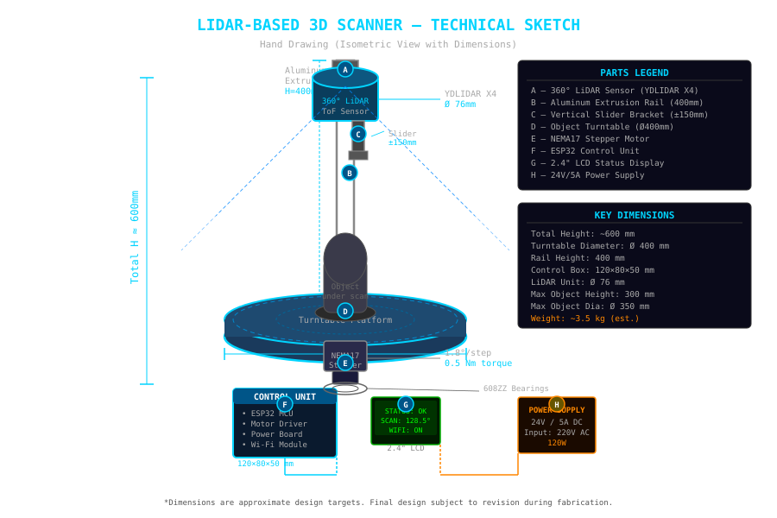
04 — IMPLEMENTATION | Technical Hand Sketch (3D View)
7 / 12
* Hand-drawn design sketch — all dimensions in mm — final design subject to revision during fabrication phase

Slide 8
05 — COMPONENTS USED & TECHNOLOGIES
8 / 12
Category | Component | Spec / Notes
LiDAR Sensor | YDLIDAR X4 | Range 0.12–10m, 0.5° res., UART
Microcontroller | ESP32 WROOM | 240 MHz, Wi-Fi/BLE, FreeRTOS, ~$5
Stepper Motor | NEMA17 (42HS40) | 1.8°/step, 0.5 Nm, 12V, ~$15
Motor Driver | TMC2209 | Microstepping, silent, SPI/UART
Encoder | AS5048A Magnetic (1024C) | SPI, absolute angle feedback
IMU | MPU-6050 | 6-DOF, I2C, vibration detection
Display | 2.4" ILI9341 LCD | SPI, status/scan info display
Storage | SD Card Module (32GB) | FAT32, SPI, raw point cloud buffer
Power Supply | 24V 5A DC Adapter | Input 220V AC, 120W rated
Frame | Aluminum Extrusion 2020 | 400mm rails, T-nuts, corner brackets
Bearings | 608ZZ Ball Bearings (×4) | 8mm bore, low-friction rotation
Firmware | Arduino IDE + FreeRTOS | ESP32 C/C++, stepper + LiDAR tasks
Processing | Python + PCL + Open3D | Point cloud filter, mesh reconstruction
Backend | Flask (Python) | REST API for file management
Frontend | React + Three.js | Web dashboard, 3D model viewer
Cloud | AWS S3 / Firebase | File upload, remote access, HTTPS

Slide 9
06 — EXPECTED BUDGET (LKR)
9 / 12
Exchange rate used: 1 USD ≈ LKR 305 (approx. May 2025)
Component / Item | Cost (USD) | Cost (LKR)
YDLIDAR X4 LiDAR Sensor | $100 | 30,500
ESP32 WROOM Dev Board | $5 | 1,525
NEMA17 Stepper Motor (×2) | $30 | 9,150
TMC2209 Motor Driver (×2) | $15 | 4,575
AS5048A Magnetic Encoder | $12 | 3,660
MPU-6050 IMU Module | $3 | 915
2.4" ILI9341 LCD Display | $5 | 1,525
Aluminum Extrusion 2020 (4×500mm) | $20 | 6,100
Ball Bearings 608ZZ (×4) | $5 | 1,525
Object Turntable Platform (custom) | $25 | 7,625
Custom PCB / Prototype Board | $30 | 9,150
SD Card Module + 32GB Card | $8 | 2,440
24V 5A Power Supply | $18 | 5,490
Wiring, Connectors, Misc. | $20 | 6,100
3D Printed Parts / Enclosure | $25 | 7,625
Fasteners, Hardware | $10 | 3,050
Cloud (AWS Free Tier / Firebase) | $0 | 0
TOTAL ESTIMATED COST | ~$331 | 100,955
* Costs are estimates. Actual prices may vary with local market, shipping, and exchange rate.

Slide 10
07 — WORK DISTRIBUTION
10 / 12
⚙
Hardware Engineer
💻
Embedded SW Engineer
🔧
Mechanical Engineer
IT25001
IT25002
IT25003
Sensor: LiDAR Sensor (YDLIDAR X4)
Sensor: ESP32 MCU & Motor Control
Sensor: Encoder & Turntable System
• LiDAR UART driver development
• FreeRTOS firmware architecture
• Turntable CAD design & fabrication
• Point cloud data acquisition
• Stepper motor control (TMC2209)
• Encoder integration & testing
• Sensor calibration & testing
• Data buffering & SD card write
• Rail frame assembly
• PCB layout for sensor interface
• Wi-Fi / MQTT communication
• Load capacity & wobble validation
📊
Data Processing Engineer
🌐
UI/UX Developer
IT25004
IT25005
Sensor: IMU & Point Cloud Processing
Sensor: LCD Display & Web Frontend
• PCL / Open3D pipeline development
• LCD status display firmware
• Filtering, meshing algorithms
• React web dashboard
• 3D model export (PLY/OBJ/STL)
• Three.js 3D model viewer
• Cloud upload & storage scripts
• Flask REST API integration

Slide 11
08 — PROJECT TIMELINE (12 Months)
11 / 12
M1
M2
M3
M4
M5
M6
M7
M8
M9
M10
M11
M12
Planning & Requirements
Component Selection & Order
Mechanical Design (CAD)
Firmware Architecture
Hardware Assembly
Electronics & PCB
LiDAR Integration & Test
Processing Pipeline (PCL)
Cloud & Web Dashboard
Calibration & Accuracy Test
Final Integration & Demo
Report & Documentation
Honest Note: This is a high-complexity project (Hardware + Software + Algorithms). 12 months is realistic for a dedicated 5-person team with weekly milestones. Delays in component delivery (lead times) are the main risk.

Slide 12
09 — REFERENCES
12 / 12
[1]
Slamtec RPLIDAR A2M8 Datasheet
cdn.sparkfun.com/assets/...rplidar_datasheet_A2M8_v1.0_en.pdf
[2]
Slamtec RPLIDAR A3M1 Datasheet
generationrobots.com/media/...rplidar_datasheet_A3M1_v1.0_en.pdf
[3]
YDLIDAR X4 Datasheet
elecrow.com/download/X4_Lidar_Datasheet.pdf
[4]
Slamtec RPLIDAR S1 Product Page
mybotshop.de/SLAMTEC-RPLIDAR-S1-360-Laser-Scanner-40-m
[5]
Velodyne VLP-16 Datasheet
velodynelidar.com (Ouster/Velodyne technical specifications)
[6]
Building the Ultimate Turntable for 3D Scanning
blog.arduino.cc/2026/02/12/building-the-ultimate-turntable-for-3d-scanning/
[7]
Motorized 3D Scanning Turntable — Hackster.io
hackster.io/mertarduino/how-to-build-a-motorized-3d-scanning-turntable-567634
[8]
Point Cloud Library (PCL) Documentation
pointclouds.org/documentation/
[9]
Open3D Library Documentation
open3d.org/docs/release/
[10]
ESP32 Technical Reference Manual
espressif.com/en/products/socs/esp32
[11]
FreeRTOS Kernel Documentation
freertos.org/Documentation/
[12]
AWS S3 Developer Guide
docs.aws.amazon.com/AmazonS3/latest/userguide/
[13]
IEC 60825-1:2014 — Laser Safety Standard
iec.ch/publication/3587
[14]
Rusu, R.B. & Cousins, S. (2011). 3D is here: Point Cloud Library
IEEE ICRA, Shanghai, 2011
[15]
Zhou, Q.-Y., Park, J., Koltun, V. (2018). Open3D: A Modern Library for 3D Data Processing
arXiv:1801.09847
Thank You | B25 FIT Level 01 Project | LiDAR-Based 3D Scanner

